Slide 1
FORMULA 1 WORLD CHAMPIONSHIP (1950 - 2024) USING SQL
Name:- Krupa Prakash Diwani
Batch:- KL352

Slide 2
PROJECT OBJECTIVE
To analyze Formula 1 driver, constructor, race, circuit, and qualifying data using SQL.
To identify top-performing drivers and constructors based on race results and points.
To analyze qualifying performance and race outcomes to understand driver performance.
To study season-wise, race-wise, and circuit-wise Formula 1 trends.
To apply SQL concepts including DDL, DML, DQL, clauses, functions, joins, window functions, subqueries, and views.
To generate meaningful insights and data-driven recommendations from historical Formula 1 data.

Slide 3
DATASET DESIGN DATASET NAME:- World Championship (1950-2024) dataset TOTAL RECORDS:- 38,650
Drivers Table :-
driverId — PRIMARY KEY
driverRef
number
code
forename
surname
dob
nationality
url
Constructors Table :-
constructorId — PRIMARY KEY
constructorRef
name
nationality
url

Slide 4
Circuits Table :-
circuitId — PRIMARY KEY
circuitRef
name
location
country
lat
lng
alt
url
Races Table :-
raceId — PRIMARY KEY
year
round
circuitId — FOREIGN KEY → circuits(circuitId)
name
date
time
url

Slide 5
Results Table :-
resultId — PRIMARY KEY
raceId — FOREIGN KEY → races(raceId)
driverId — FOREIGN KEY → drivers(driverId)
constructorId — FOREIGN KEY → constructors(constructorId)
number
grid
position
positionText
positionOrder
points
laps
time
milliseconds
fastestLap
rank
fastestLapTime
fastestLapSpeed
statusId
Qualifying Table :-
qualifyId — PRIMARY KEY
raceId — FOREIGN KEY → races(raceId)
driverId — FOREIGN KEY → drivers(driverId)
constructorId — FOREIGN KEY → constructors(constructorId)
number
position
q1
q2
q3

Slide 6
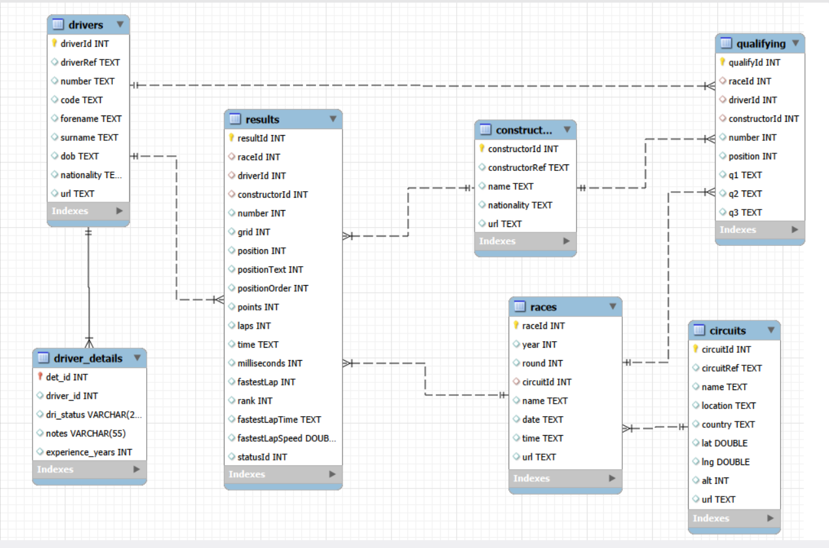
DATASET DESIGN

Slide 7
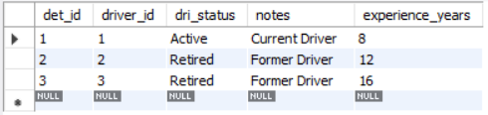
QUERIES
CREATE:-
create table driver_details
(det_id int primary key,
driver_id int not null,
dri_status varchar(25),
dri_note varchar(55));
RENAME:-
alter table driver_details
rename column dri_note to notes;
ALTER:-
alter table driver_details
add experience_years int;
INSERT:-
insert into driver_details
(det_id, driver_id, dri_status, notes, experience_years)
Values
(1, 1, "Active", "Current Driver", 8),
(2, 2, "Retired", "Former Driver", 12),
(3, 3, "Retired", "Former Driver", 16);

Slide 8
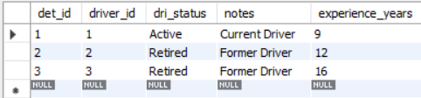

DATA MANIPULATION LANGUAGE (DML)
UPDATE:-
update driver_details
set experience_years= 9
where det_id=1;
DELETE:- delete from driver_details
where det_id=3;

Slide 9

DATA DEFINITION LANGUAGE (DDL)
TRUNCATE:- truncate table driver_details;
DROP:-
drop table driver_details;

Slide 10
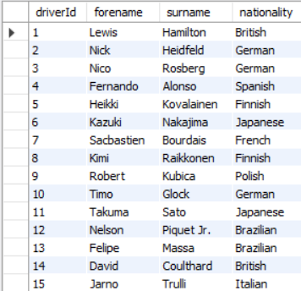
DATA QUERY LANGUAGE (DQL)
SELECT:-
Select driverId, forename, surname, nationality FROM drivers;

Slide 11
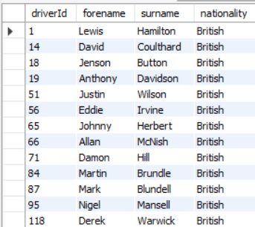
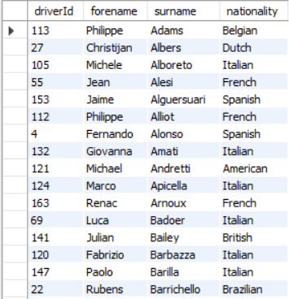
SQL CLAUSES
WHERE:-
select driverId, forename, surname, nationality
from drivers
where nationality = 'British';
ORDER BY:-
select driverId, forename, surname, nationality
from drivers
order by surname asc;
INSIGHT
This isolates British drivers and provides a focused view of their representation in the championship.
INSIGHT
Alphabetical ordering makes a large historical driver list easier to search and review.

Slide 12
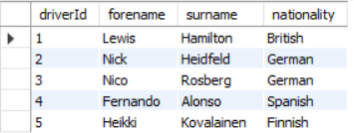
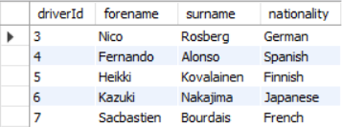
LIMIT:-
select driverId, forename, surname, nationality
from drivers
limit 5;
INSIGHT
Limiting the output provides a smaller sample for quickly inspecting a large dataset.
OFFSET:-
select driverId, forename, surname, nationality
from drivers
limit 5 offset 2;
INSIGHT
This approach supports viewing data page by page. It skips the first 2 drivers and shows the next 5 drivers.

Slide 13
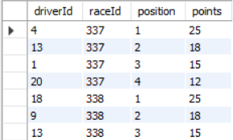
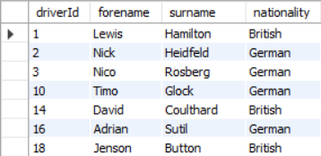
SQL OPERATORS
AND:-
select driverId, raceId, position, points
from results
where position <= 5 and points > 10;
INSIGHT
The query identifies drivers who achieved both a top-5 finish and a high points score.
OR:-
select driverId, forename, surname, nationality
from drivers
where nationality = 'British' or nationality = 'German';
INSIGHT
The query brings together British and German drivers for comparison.

Slide 14
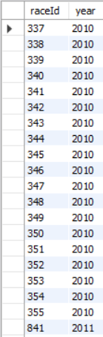
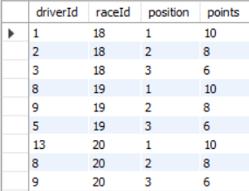
BETWEEN:-
select raceId, year from races
where year
between 2010 and 2020
order by year asc;
INSIGHT
The query focuses on races held between 2010 and 2020 for analysis.
IN:-
select driverId, raceId, position, points from results where position in (1, 2, 3);
INSIGHT The query shows drivers who finished in the top 3 positions in a race.

Slide 15
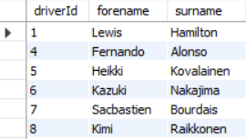
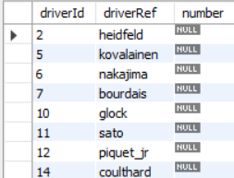
LIKE:-
select driverId, forename, surname
from drivers
where surname like '%a%';
INSIGHT
Pattern matching makes it possible to find names without knowing the complete surname.
IS NULL:- select driverId, driverRef, number
from drivers
where number is null;
INSIGHT
The query identifies drivers whose car number information is missing in the dataset.

Slide 16


AGGREGATE FUNCTIONS
COUNT:- select count(*) as total_constructors from constructors;
INSIGHT
There are 212 constructors recorded in the selected dataset.
SUM:- select sum(points) as total_points from results;
INSIGHT
The value represents the combined points recorded across all race-result records.

Slide 17



AVERAGE:-
select avg(position) as average_qualifying_position from qualifying;
INSIGHT
The average gives an overall indication of the typical qualifying position across the available qualifying records.
MIN:- select min(year) as earliest_race_year from races;
INSIGHT
The value identifies the starting year of the race history available in the dataset.
MAX:- select max(alt) as highest_circuit_altitude from circuits;
INSIGHT
The value identifies the highest-altitude circuit represented in the dataset.

Slide 18
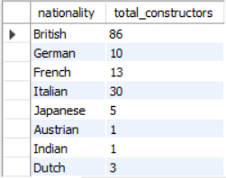
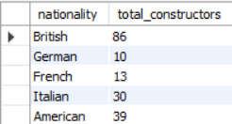
GROUP BY & HAVING
GROUP BY:-
select nationality, count(*) as total_constructors
from constructors
group by nationality;
INSIGHT
This gives the number of constructors represented by each nationality.
GROUP BY & HAVING:- select nationality, count(*) as total_constructors
from constructors
group by nationality
having count(*) > 5;
INSIGHT
These nationalities have a larger representation of constructors.

Slide 19
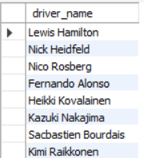
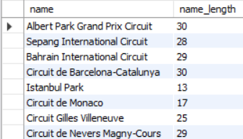
STRING FUNCTIONS
CONCAT:-
select concat(forename, ' ', surname) as driver_name
from drivers;
INSIGHT
The driver's first name and surname are combined into a single readable name.
LENGTH:- select name, length(name) as name_length from circuits;
INSIGHT
The output gives the number of characters in each circuit name.

Slide 20
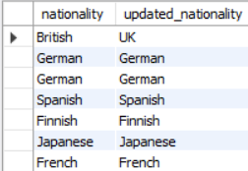
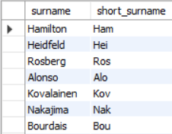
REPLACE:-
select nationality,
replace(nationality, 'British', 'UK') as updated_nationality
from drivers;
INSIGHT
British nationality values are displayed as UK without changing the original data.
SUBSTRING:- select surname, substring(surname, 1, 3) as short_surname
from drivers;
INSIGHT The query extracts the first three characters from each driver's surname, giving a shortened version of the name.

Slide 21
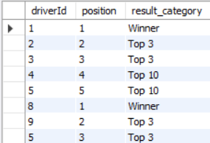
CONDITIONAL FUNCTIONS
CASE:-
select driverId, position,
case
when position = 1 then 'Winner'
when position <= 3 then 'Top 3'
when position <= 10 then 'Top 10'
else 'Outside Top 10’
end as result_category
from results;
INSIGHT
The finishing positions are divided into simple performance categories such as Winner, Top 3 and Top 10.

Slide 22
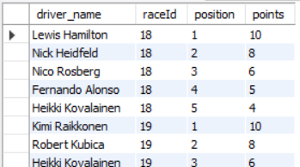
JOINS
INNER JOIN:-
select concat(d.forename, ' ', d.surname) as driver_name, r.raceId, r.position, r.points
from drivers d
inner join results r
on d.driverId = r.driverId;
INSIGHT
Driver information is connected with race performance, making individual results easier to interpret.

Slide 23
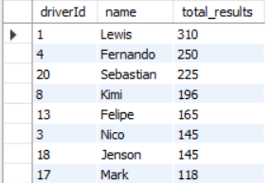
LEFT JOIN:-
select d.driverId, d.forename as name, count(r.resultId) as total_results
from drivers d
left join results r
on d.driverId = r.driverId
group by d.forename
having count(r.resultId) > 20
order by total_results desc;
INSIGHT
The ranking highlights drivers with more than 20 recorded race results.

Slide 24
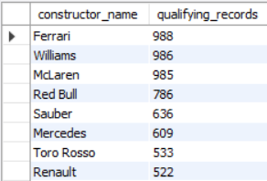
RIGHT JOIN:-
select c.name as constructor_name, count(q.qualifyId) as qualifying_records
from constructors c
right join qualifying q
on c.constructorId = q.constructorId
group by c.constructorId, c.name
order by qualifying_records desc;
INSIGHT
The ranking identifies constructors with the highest number of recorded qualifying results.

Slide 25
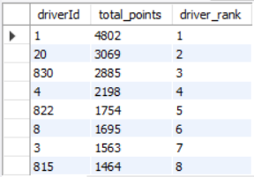
WINDOW FUNCTIONS
RANK:-
select driverId, sum(points) as total_points,
rank() over(order by sum(points) desc) as driver_rank
from results
group by driverId;
INSIGHT
Drivers are ranked according to their overall points, with equal points receiving the same rank.

Slide 26
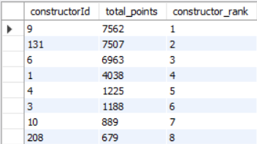
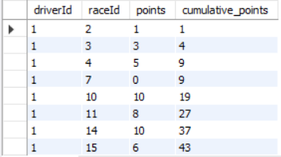
DENSE RANK:-
select constructorId, sum(points) as total_points,
dense_rank() over(order by sum(points) desc) as constructor_rank
from results
group by constructorId;
INSIGHT
Constructors receive a continuous ranking based on their total points.
PARTITION:- select driverId, raceId, points,
sum(points) over(partition by driverId order by raceId) as cumulative_points
from results;
INSIGHT
The cumulative value tracks how a driver's total points build up over their races.

Slide 27

SUBQUERIES
select driverId, raceId, points
from results
where points = (
select max(points)
from results);
INSIGHT
The output identifies the strongest individual points performance recorded in the dataset.

Slide 28
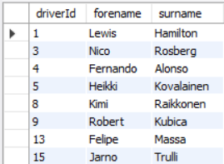
select driverId, forename, surname
from drivers
where driverId in (
select driverId
from results
where position = 1);
INSIGHT
The list contains drivers who have recorded at least one race victory.

Slide 29
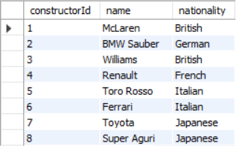
VIEWS
CREATE VIEW:-
create view constructor_information as
select constructorId, name, nationality
from constructors;
select * from constructor_information;
INSIGHT
The view provides a simple reusable source for constructor information.

Slide 30
BUSINESS RECOMMENDATION
Focus on constructors with consistently high point totals to identify successful team strategies.
Analyze drivers who frequently gain positions after qualifying to understand race-day performance advantages.
Study high-activity circuits for historical performance trends.
Monitor season-wise rankings to evaluate long-term driver and constructor consistency.
Use qualifying versus race-result analysis to measure driver effectiveness under race conditions.

Slide 31
CONCLUSION
Successfully analyzed Formula 1 historical data using SQL.
Used six related Kaggle tables for the analysis.
Compared drivers, constructors, races, circuits and qualifying performance.
Applied SQL concepts from basic to advanced levels.
Generated meaningful insights from race and performance data.
Demonstrated how SQL can turn Formula 1 historical data into useful information for analysis and decision-making.

